Slide 1

Probability and Statistics
(Software Engineering)
Instructor
Dr. Bakhtawar

Slide 2
Quantiles
From the definition of median that it’s the middle point and further it is divided the area under the curve for two areas have the same area in the left, and in the right. From this
may be divided the area under the curve for four equally area and this called quartiles

Slide 3
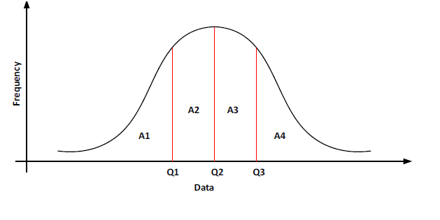
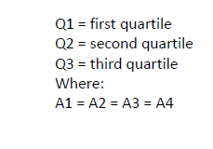
Quantiles

Slide 4
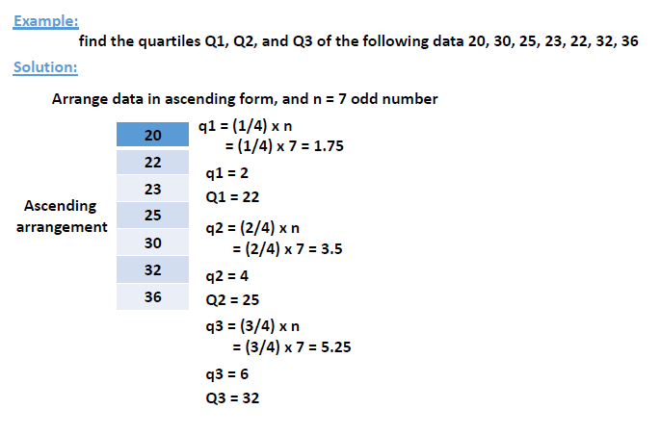

Slide 5
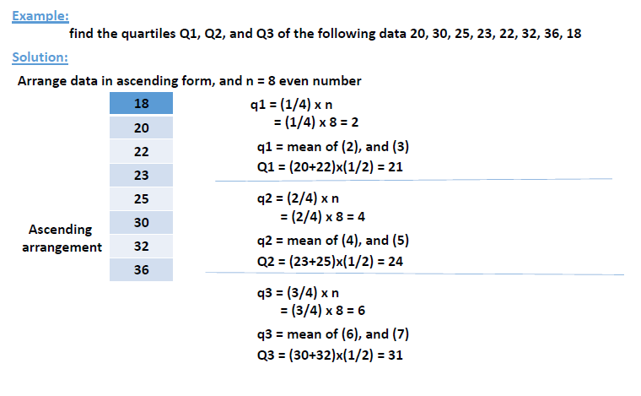

Slide 6
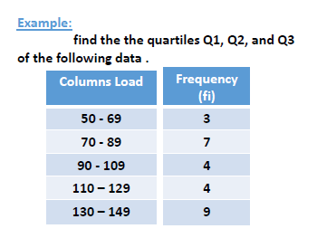

Slide 7
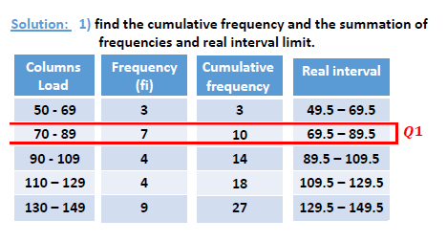

Slide 8
2). find the arrangement number of quartiles to find quartile interval 1.
q1 = (1/4) x n = (1/4) x 27 = 6.75
The interval of quartile number 1 is have the cumulative frequency = 10
L = the real lower limit of quartiles interval or class boundaries = 69.5
c = cumulative frequency of the previous value= 3
f = the frequency of quartiles interval = 7
h = the length of quartiles interval = 20

Slide 9


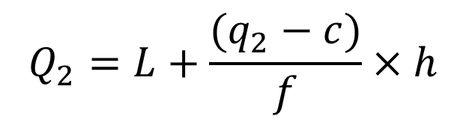
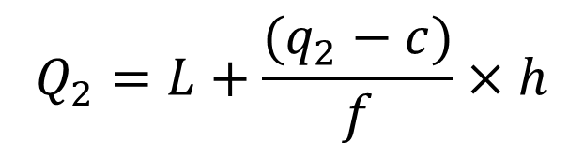
Quantiles
$$Q_{1}=L+\frac{(q_{1}−c)}{f}×h$$
$$Q_{1}=69.5+\frac{(6.75−3)}{7}×20$$
$$Q_{1}=80.2$$
$$Q_{2}=L+\frac{(q_{2}−c)}{f}×h$$
$$Q_{2}=L+\frac{(q_{2}−c)}{f}×h$$

Slide 10

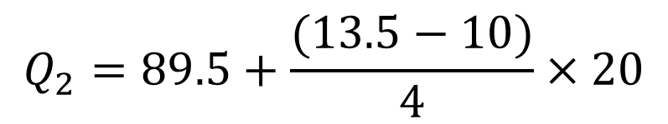
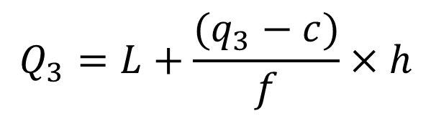

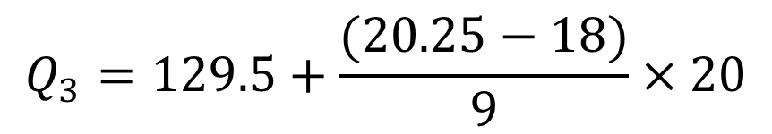
Quantiles
$$Q_{2}=89.5+\frac{(13.5−10)}{4}×20$$
$$Q_{2}=107$$
$$Q_{3}=L+\frac{(q_{3}−c)}{f}×h$$
$$Q_{3}=129.5+\frac{(20.25−18)}{9}×20$$
$$Q_{3}=134.5$$

Slide 11
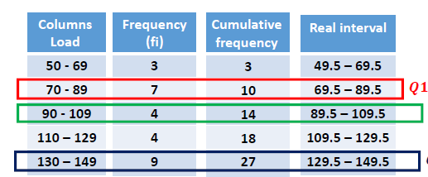

Slide 12
Number | Frequency
1 – 3 | 7
4 – 6 | 6
7 – 9 | 4
10 – 12 | 2
13 – 15 | 13
16 – 18 | 8
19 – 21 | 1
22 – 24 | 9
25 – 27 | 5
28 – 30 | 3

Slide 13
Measure of Dispersion
Measures of Dispersion: Sometimes when two or more different data sets are to be compared using measure of central tendency or averages, we get the same result.
Consider the runs scored by two batsmen in their last ten matches as follows:
Batsman A: 30, 91, 0, 64, 42, 80, 30, 5, 117, 71
Batsman B: 53, 46, 48, 50, 53, 53, 58, 60, 57, 52

Slide 14
Measure of Dispersion
Clearly, mean of the runs scored by both the batsmen A and B is same i.e. 53
Can we say that the performance of two players is same? Clearly No, because the variability in the scores of batsman A is from 0 to 117, whereas, the variability of the runs scored by batsman B is from 46 to 60.

Slide 15
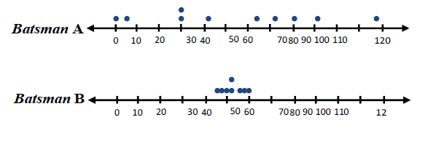
Measure of Dispersion
Let us now plot the above scores as dots on a number line. We find the following diagrams:

Slide 16
Measure of Dispersion
We can see that the dots corresponding to batsman B are close to each other and is gathered around the measure of central tendency (mean), while those corresponding to batsman A are scattered or more spread out.
Thus, the measures of central tendency are not sufficient to give complete information about a given data. In such a situation the comparison becomes very difficult.

Slide 17
Measure of Dispersion
We therefore, need some additional information for comparison, concerning with, how the data is dispersed about (more spread out) the average.
This can be done by measuring the dispersion. Like „measures of central tendency‟ we want to have a single number to describe variability. This single number is called a ‘measure of dispersion’.

Slide 18
Measure of Dispersion
Dispersion: “The variability (s p r e a d ) that exists between the value of a data is called dispersion ”.
Similarly, we have different ways of measuring and comparing the dispersion of the distribution(s). There are two important types of measures of dispersion.

Slide 19
Measure of Dispersion
Types of Measures of Dispersion:
There are two types of measure of dispersion
I) Absolute Measure of Dispersion
II) Relative Measure of Dispersion
Absolute Measure of Dispersion: “An absolute measure of dispersion measures the variability in terms of the same units of the data” e.g. if the units of the data are Rs, meters, kg, etc. The units of the measures of dispersion will also be Rs, meters, kg, etc.

Slide 20
Measure of Dispersion
The common absolute measures of dispersion are:
Range
Quartile Deviation or Semi Inter-Quartile Range
Average Deviation or Mean Deviation
Standard Deviation

Slide 21
Measure of Dispersion
The major difference b/w Absolute and Relative Measures of Dispersion is that the Absolute measure of dispersion measures only the variability of the data, further it has the unit of measurement; on the other hand Relative measure of dispersion is used to compare the variation of two or more distributions, further it is unit less.

Slide 22
Range
Range: “The difference between the largest and the smallest value in a set of data is called range ”
OR
“In continuous grouped data the difference between the upper class boundary of the highest class and lower class boundary of the lowest class is called range”
Formula:
R = Xm – X0 OR R=Largest value –smallest value
Where R is the range, Xm is the largest value and X0 is the smallest value.

Slide 23
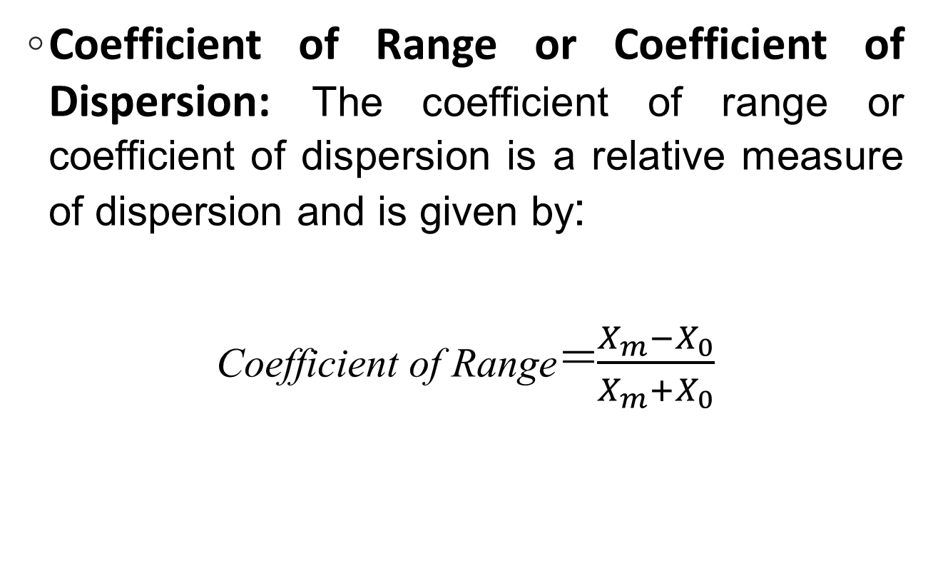
Range
Coefficient of Range or Coefficient of Dispersion: The coefficient of range or coefficient of dispersion is a relative measure of dispersion and is given by:
Coefficient of Range=$\frac{X_{m}−X_{0}}{X_{m}+X_{0}}$

Slide 24

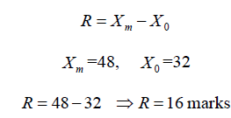
Numerical example of Range and Coefficient of range
Example
The marks obtained by 9 students are given below:

Slide 25
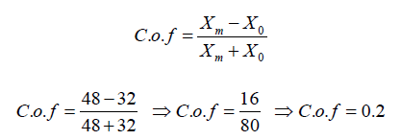
Numerical example of Range and Coefficient of range

Slide 26
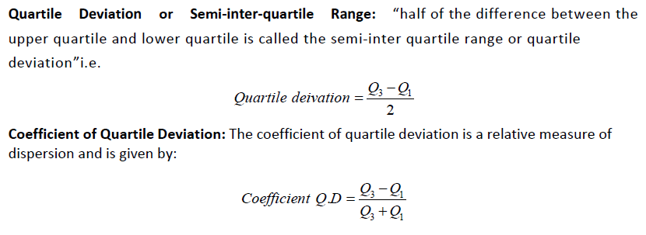
Quartile Deviation

Slide 27
Numerical example of quartile deviation and coefficient of quartile deviation (Ungrouped Data)
Example:
Calculate quartile deviation and coefficient of quartile deviation for ungrouped data.
The marks obtained by 9 students are given below:

Slide 28

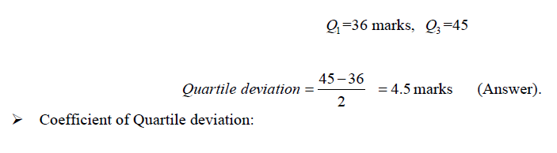
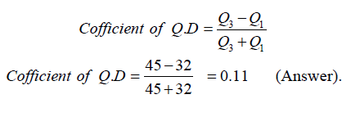
Numerical example of quartile deviation and coefficient of quartile deviation (Ungrouped Data)

Slide 29
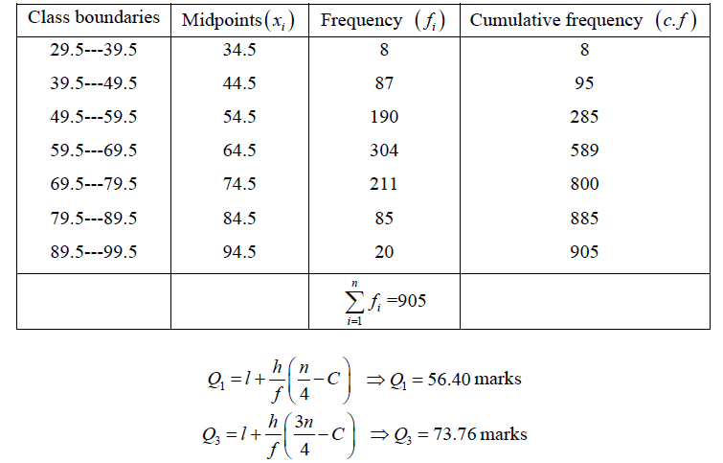
Quartile deviation and coefficient of Quartile deviation (Grouped data)

Slide 30

Mean Absolute Deviation or Mean Deviation (Average Deviation):
The arithmetic mean of the absolute deviation from an average (mean) is called mean deviation or average deviation ”.
Coefficient of Mean Deviation: The coefficient of mean deviation is a relative measure of dispersion and is given by

Slide 31

Mean Absolute Deviation or Mean Deviation (Average Deviation):

Slide 32

Numerical example of Mean deviation and Coefficient of Mean deviation for ungrouped data
Calculate the mean deviation and coefficient of mean deviation from the ungrouped data case, of the following set of examination marks

Slide 33
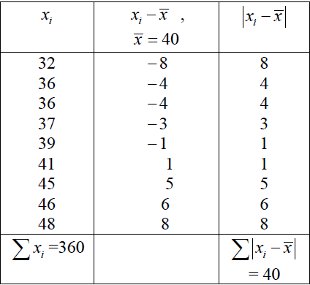
Numerical example of Mean deviation and Coefficient of Mean deviation for ungrouped data

Slide 34

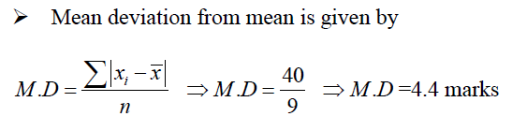


Numerical example of Mean deviation and Coefficient of Mean deviation for ungrouped data

Slide 35
Numerical example of Mean deviation and Coefficient of Mean deviation for Grouped data
➢ Calculate mean deviation and coefficient of mean deviation from mean in grouped case showing the weights of 60 apples.

Slide 36
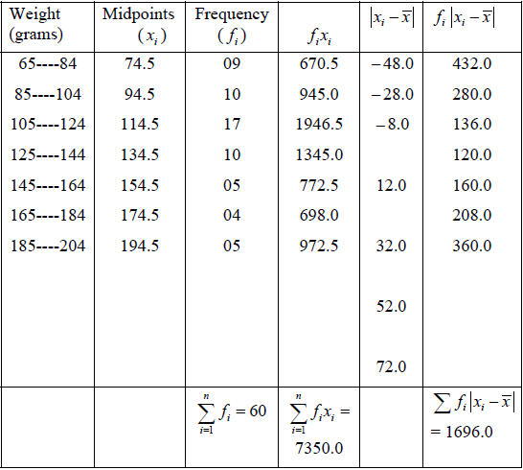

Slide 37
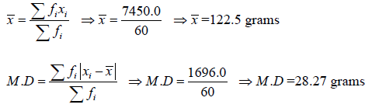
Numerical example of Mean deviation and Coefficient of Mean deviation for Grouped data

Slide 38
Standard Deviation
“The positive square root of variance is called Standard deviation”

Slide 39
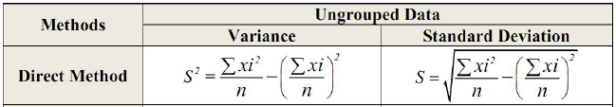
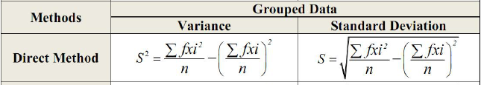
Standard Deviation

Slide 40


Coefficient of Standard Deviation

Slide 41

Numerical Solution of Standard Deviation
Coefficient of Variation was introduced by Karl Pearson. It is used to compare the variation or to compare the performance of two sets of data.
Example: Calculate the variance, S.D and C.V from the following marks obtained by 9 students.

Slide 42
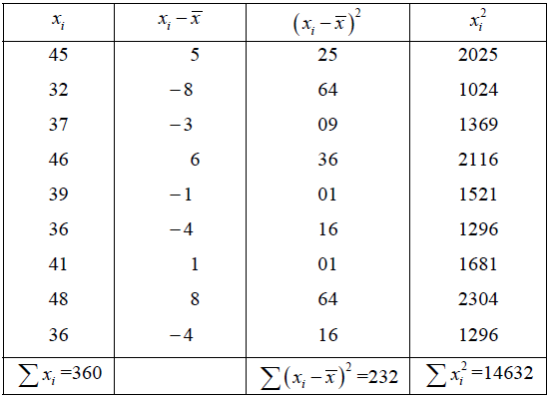
Numerical Solution of Standard Deviation

Slide 43
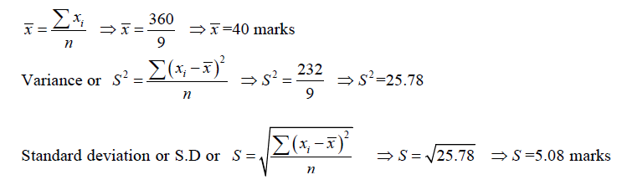
Numerical Solution of Standard Deviation

Slide 44
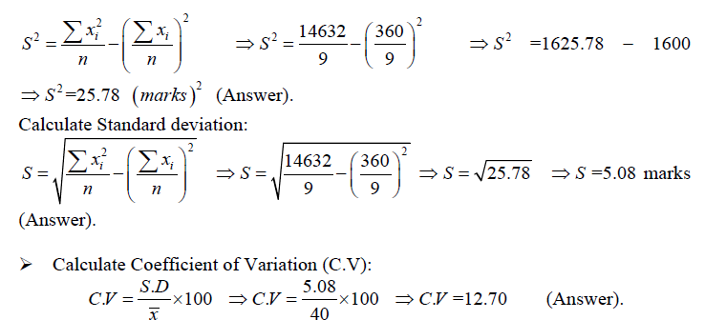
Alternative Way of Calculating Standard Deviation

Slide 45
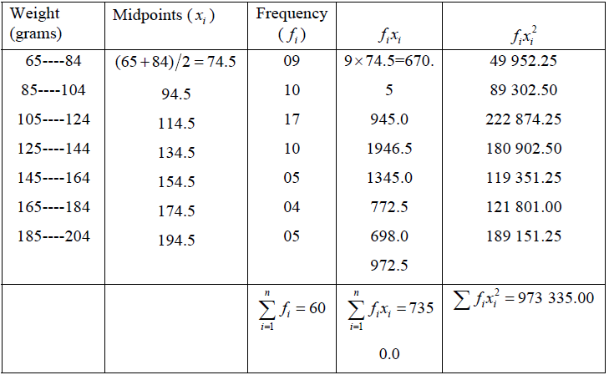
Numerical Solution of Standard Deviation for Grouped Data

Slide 46
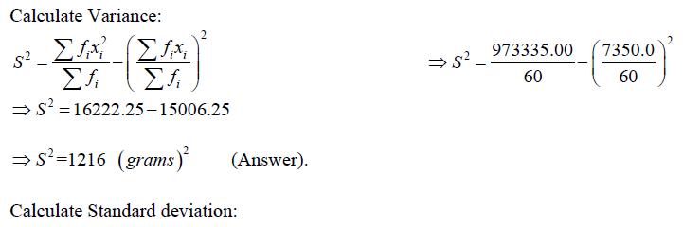
Numerical Solution of Standard Deviation for Grouped Data

Slide 47
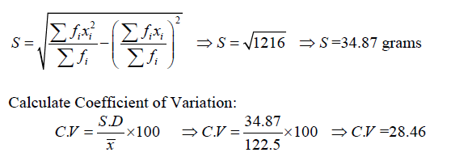
Numerical Solution of Standard Deviation for Grouped Data

Slide 48
Thank you!

